Slide 1
CSE 4539 (CSE) / CSE 4581 (BScTE (2yr) 1st Sem)
: Web Programming
Introduction to Web Programming
Department of Computer Science and Engineering
Islamic University of Technology
Notes:
Assalamualaikum, good day my respected teachers, audiences. Today I am going to present my thesis paper titled “Class Specific feature Selection for High Dimensional low sample size Data”. I am Nazmul haque and my supervisor is Dr. Mohammad Shoyaib.
Before going in detail about my Literature review, I would like to give an outline of my whole presentation.

Slide 2
Contents
Contents
Fundamental knowledge of Web Programming
HTML

Slide 3
Fundamental Knowledge
Fundamental Knowledge of Web Programming
Internet model
Layers of the internet
Web browser
Domain Name System (DNS)
Uniform Resource Locator (URL)

Slide 4
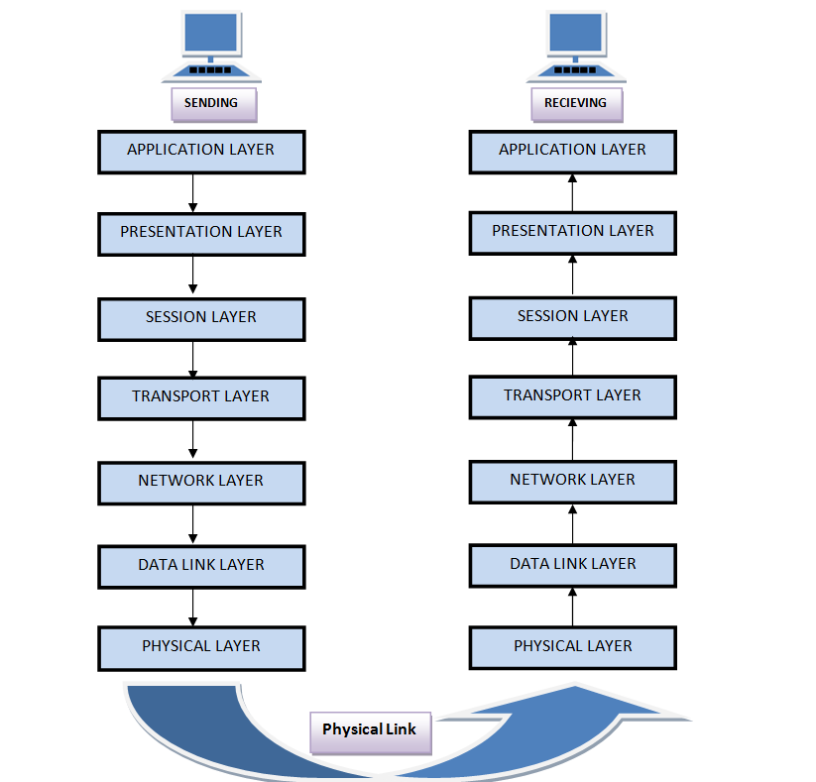
OSI Layer
Internet model (OSI Layer)
Source: https://media.router-switch.com/media/wysiwyg/Help-Center-FAQ/Router/osi-model-layers-explanation.png

Slide 5
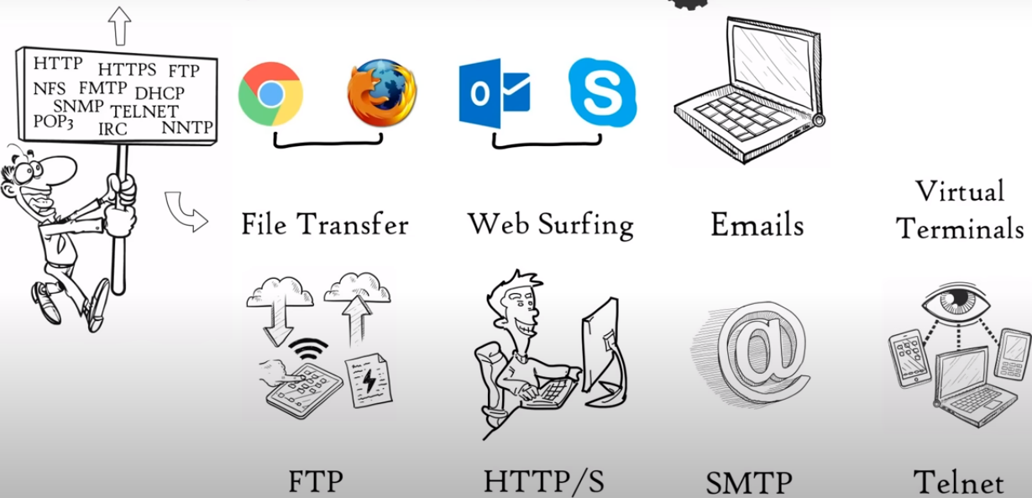
OSI Layer
Physical Layer
Source: https://www.youtube.com/watch?v=vv4y_uOneC0

Slide 6
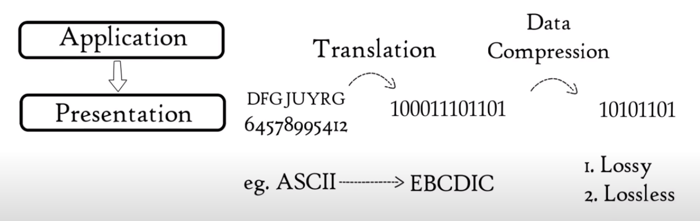
OSI Layer
Presentation Layer
Source: https://www.youtube.com/watch?v=vv4y_uOneC0

Slide 7
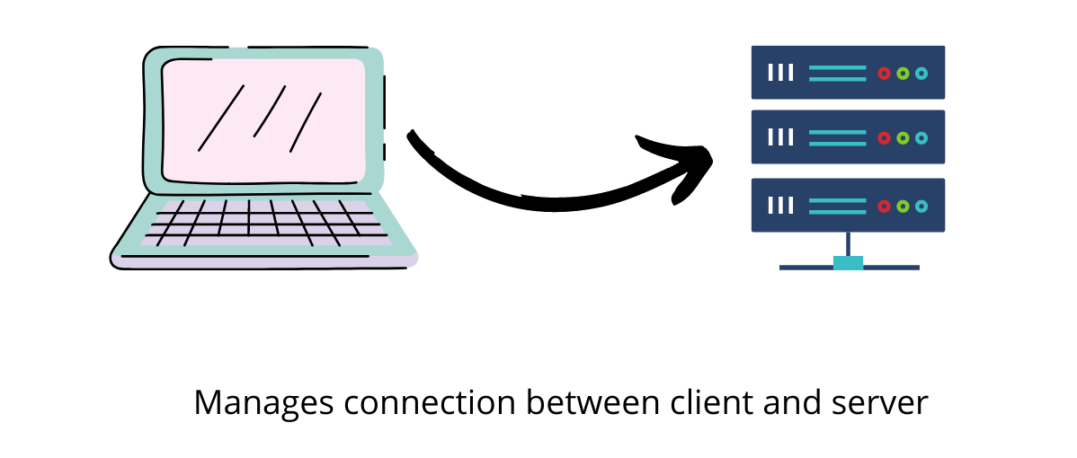
OSI Layer
Session Layer
Source: https://www.youtube.com/watch?v=vv4y_uOneC0

Slide 8
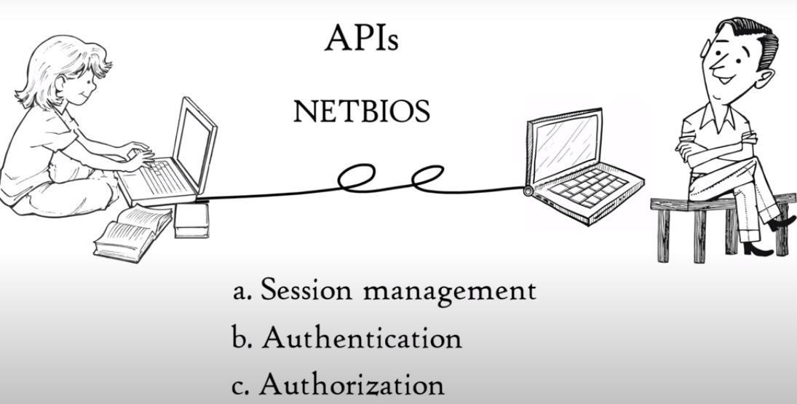
OSI Layer
Session Layer
Source: https://www.youtube.com/watch?v=vv4y_uOneC0

Slide 9

OSI Layer
Transport Layer
Source: https://www.youtube.com/watch?v=vv4y_uOneC0

Slide 10
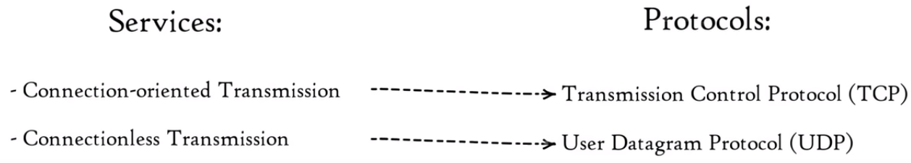
OSI Layer
Transport Layer
Source: https://www.youtube.com/watch?v=vv4y_uOneC0

Slide 11
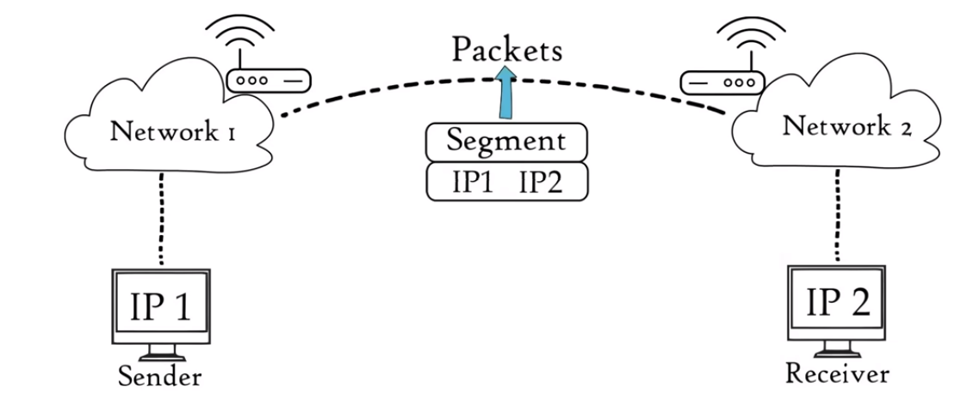
OSI Layer
Network Layer
Source: https://www.youtube.com/watch?v=vv4y_uOneC0

Slide 12
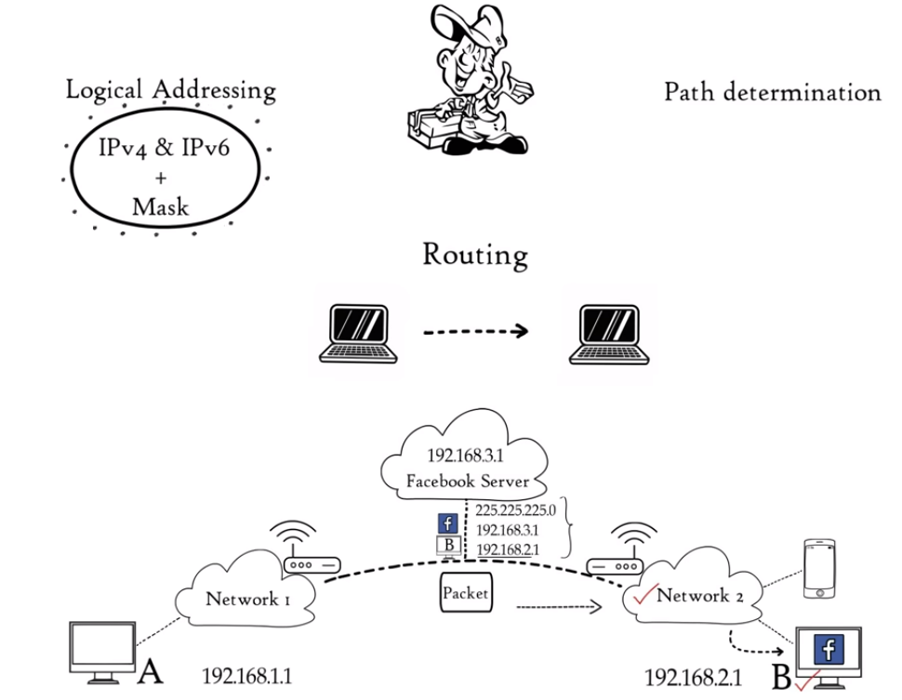
OSI Layer
Network Layer
Source: https://www.youtube.com/watch?v=vv4y_uOneC0

Slide 13
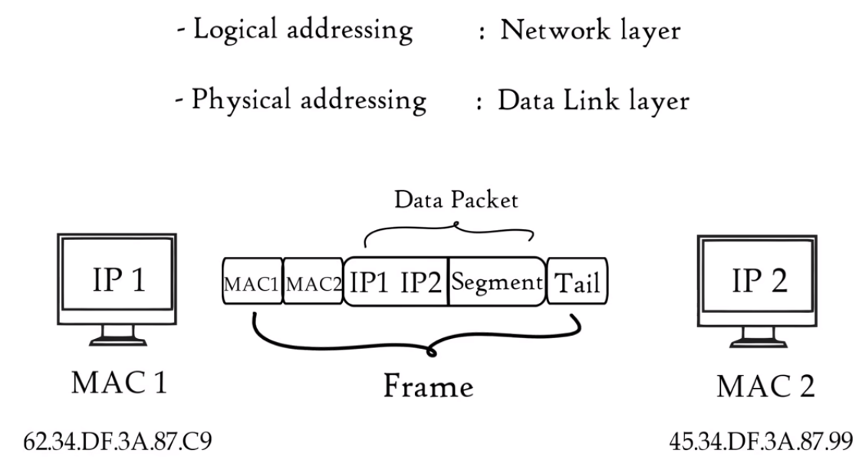
OSI Layer
Data Link Layer
Source: https://www.youtube.com/watch?v=vv4y_uOneC0

Slide 14
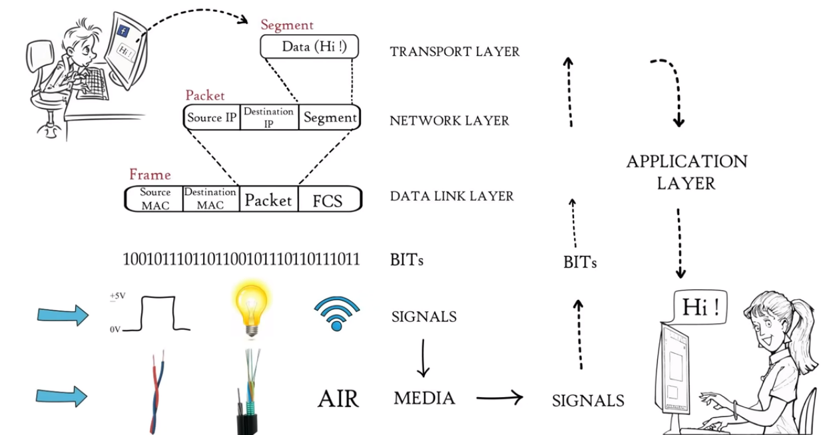
OSI Layer
Physical Layer
Source: https://www.youtube.com/watch?v=vv4y_uOneC0

Slide 15
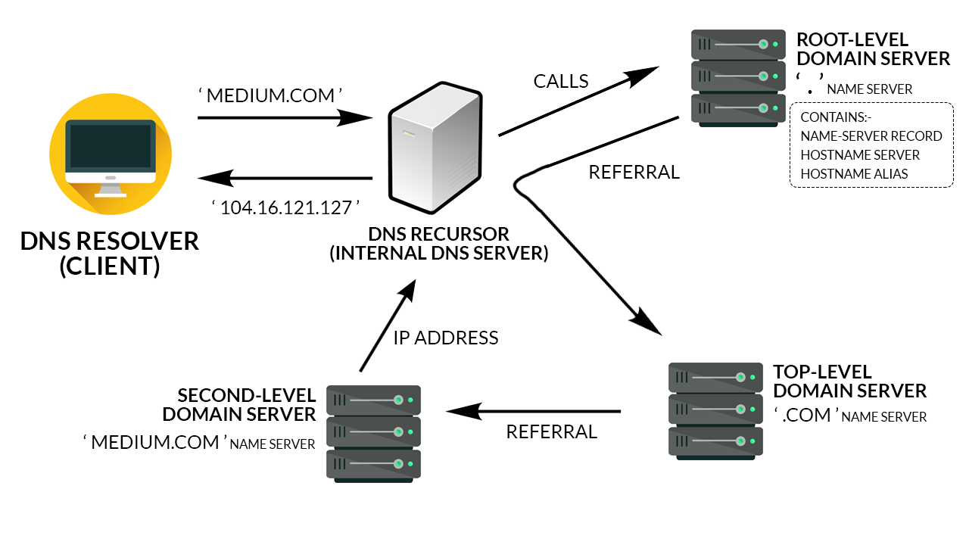
DNS
Domain Name System (DNS)

Slide 16
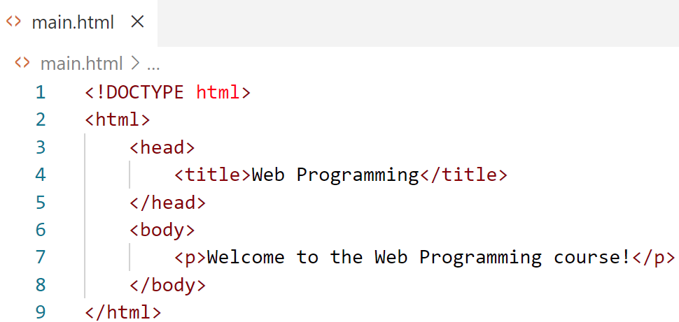
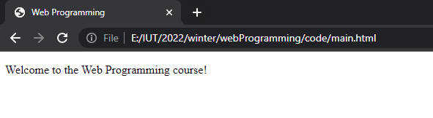
HTML
Hyper Text Markup Language (HTML)
A markup language that specifies the structure and content of documents that are displayed in web browsers

Slide 17
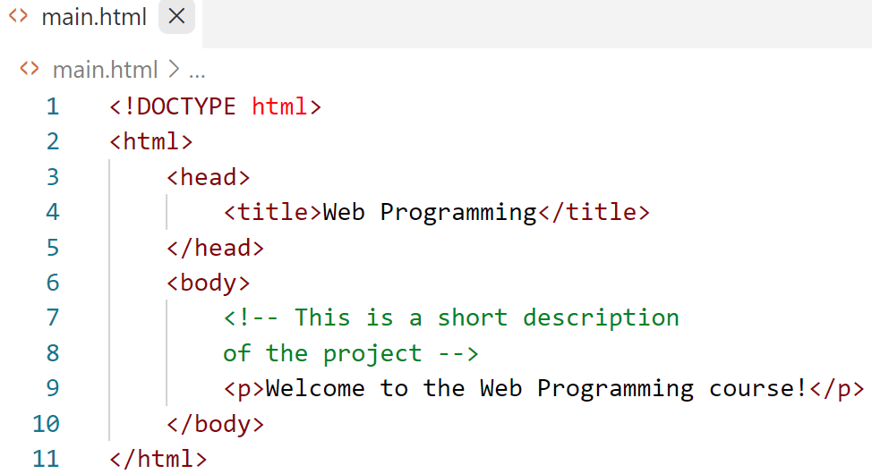
HTML
Hyper Text Markup Language (HTML)
Can use one or multi-line comments to describe an element.

Slide 18
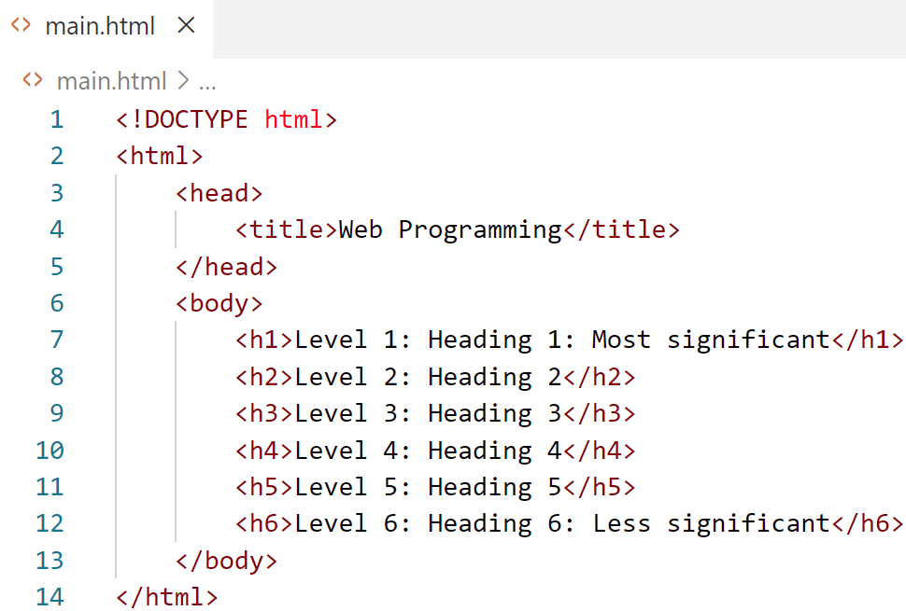
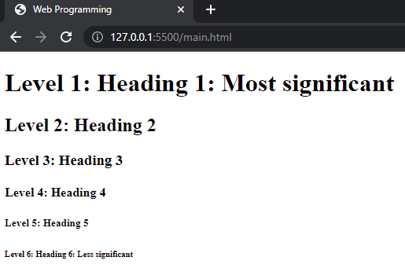
HTML
Headings
Provides six heading elements (h1 through h6) for specifying the relative importance of information

Slide 19
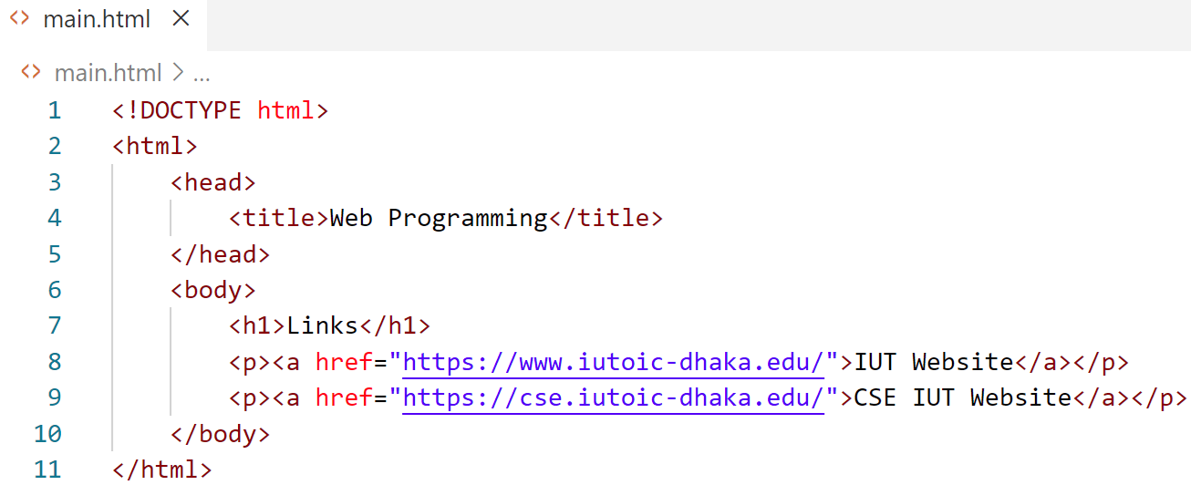
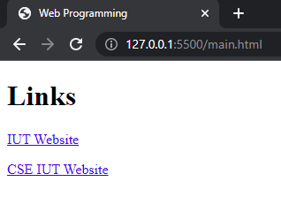
HTML
Links
References to other resources.

Slide 20
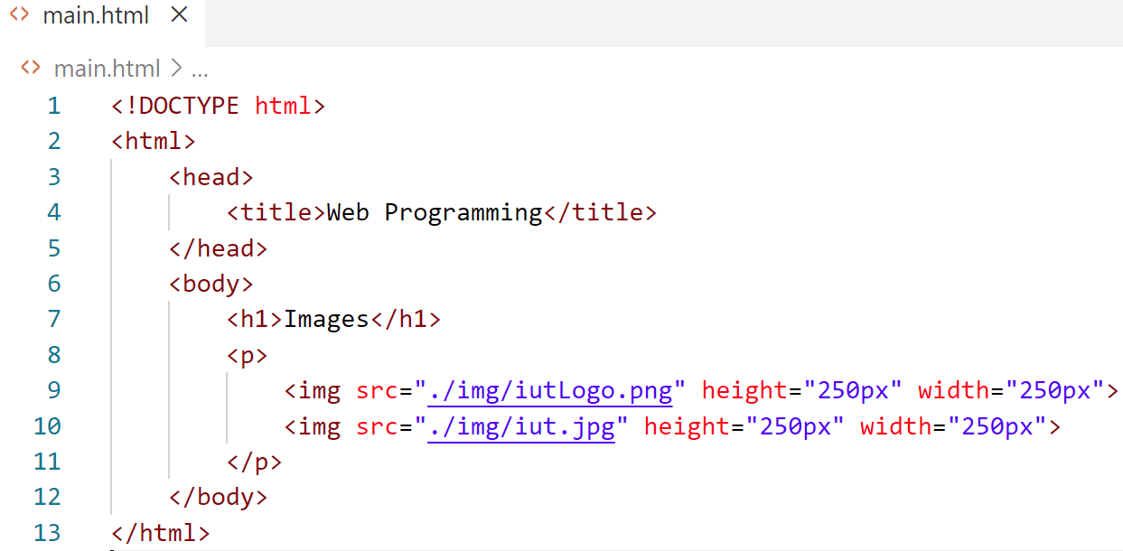
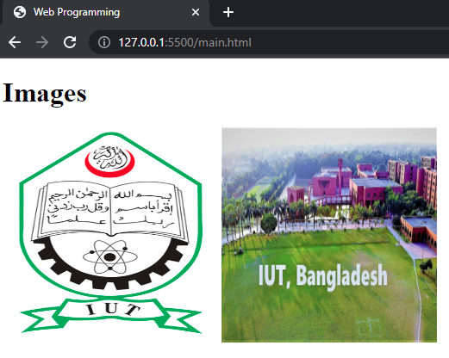
HTML
Images
Can insert images with customized height and width.

Slide 21
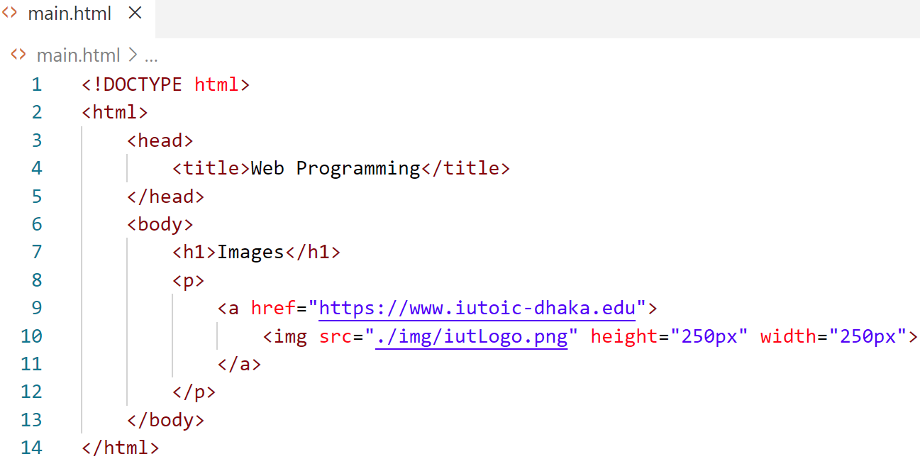

HTML
Images as links
Use images as links

Slide 22
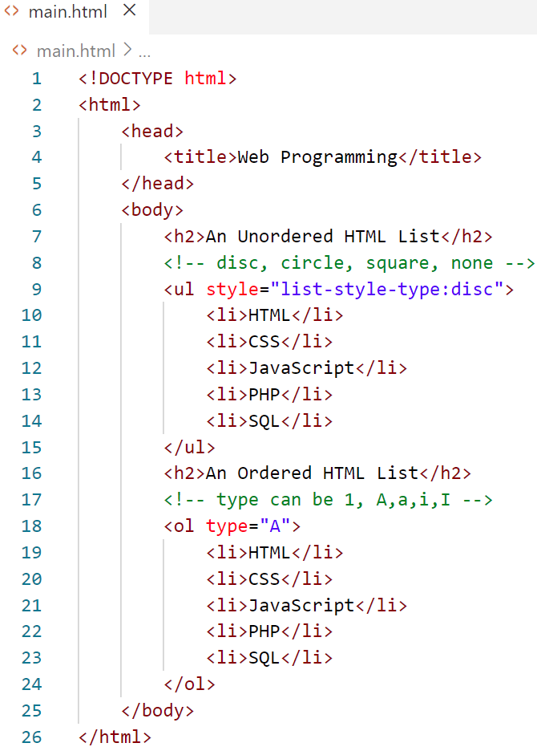
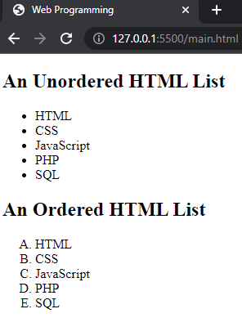
HTML
List
Unordered list: default bullet (disc)
Ordered list: default 1,2,3..

Slide 23
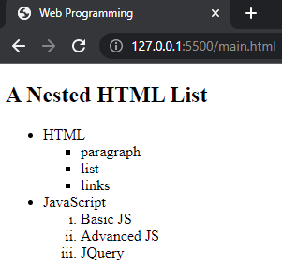
HTML
Nested List
Merge ordered and unordered lists in nested lists

Slide 24
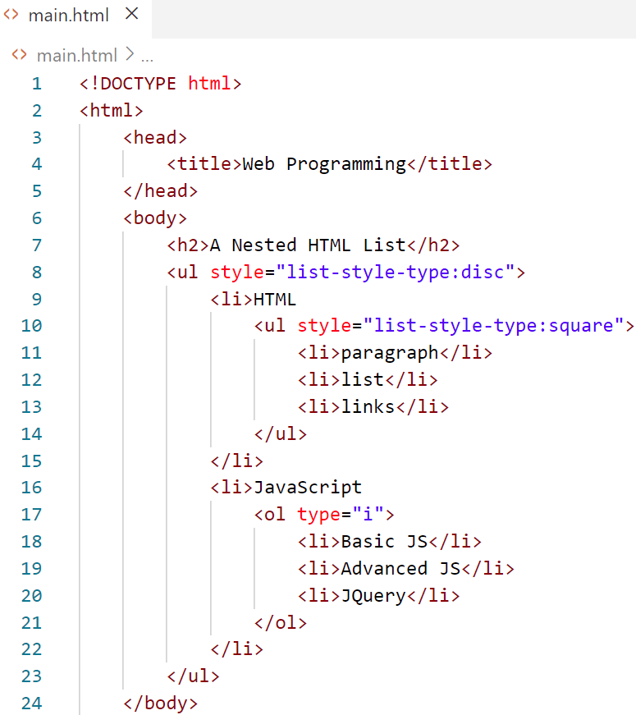
HTML
Nested List
Merge ordered and unordered lists in nested lists

Slide 25
HTML
Table
Tables are frequently used to organize data into rows and columns.
The border attribute with the value "1" specifies borders around the table.
The caption element specifies a table’s title (rendered above the table).
A table has three distinct sections—head, body and foot.
The head is defined with a thead element which contains header information.
Each tr element defines an individual table row.
The columns in the thead section are defined with th elements.

Slide 26
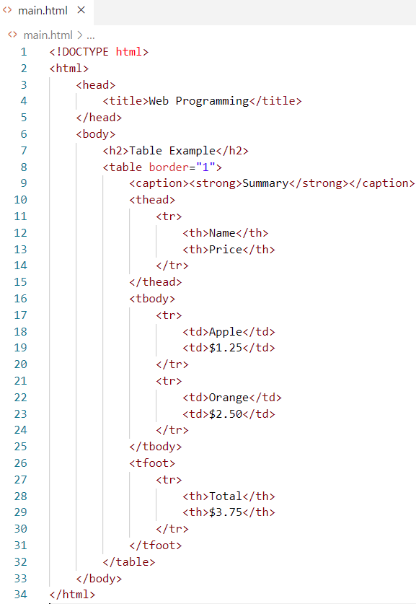
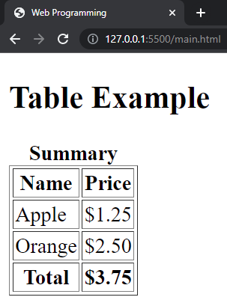
HTML
Table

Slide 27
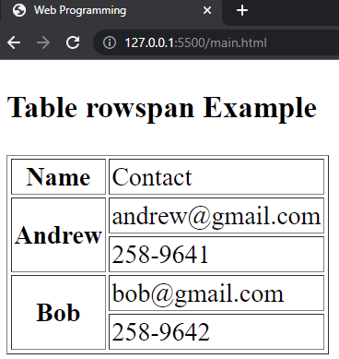
HTML
Table (row span)

Slide 28
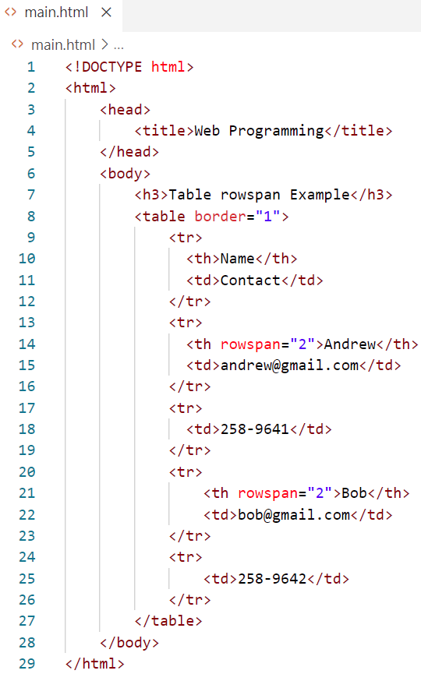
HTML
Table (row span)

Slide 29
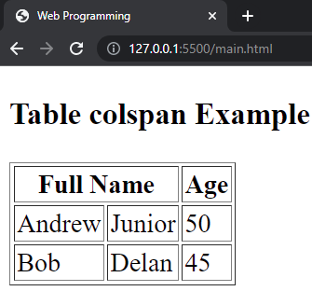
HTML
Table (column span)

Slide 30
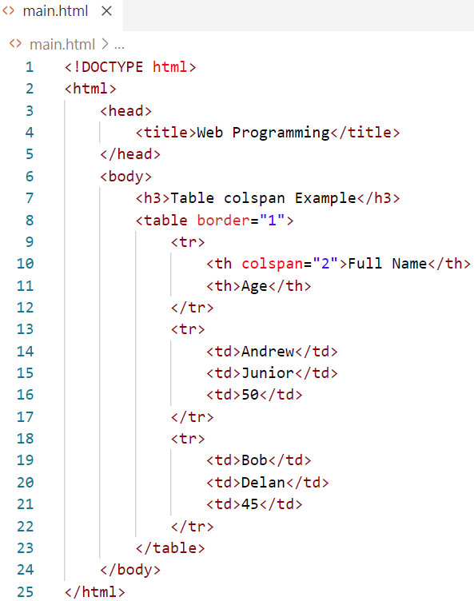
HTML
Table (column span)

Slide 31
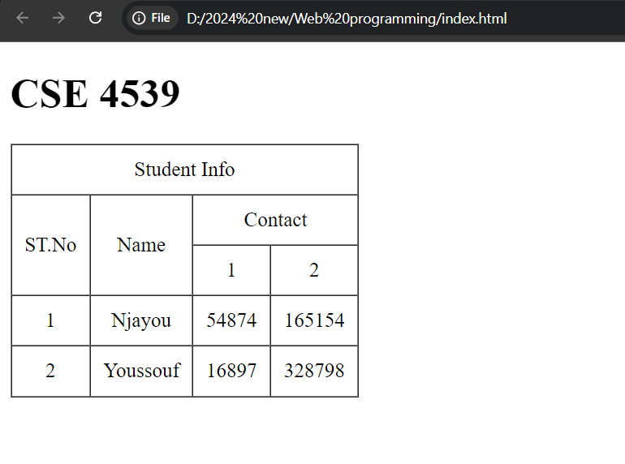
Table (column span and row span)

Slide 32
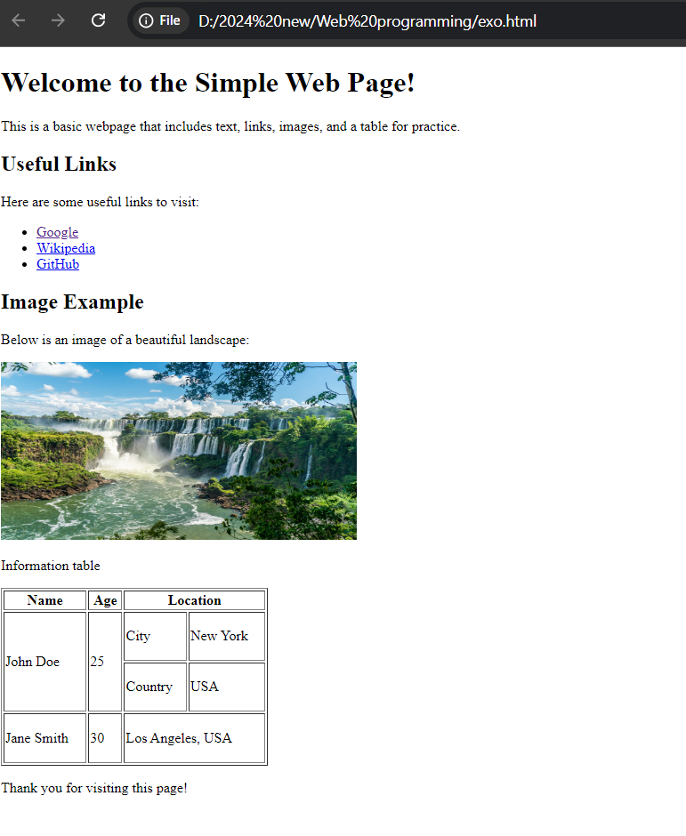

Slide 33
ANY QUESTION ?
THANK YOU !

Slide 34
References
References
[1] W3school.com

